Slide 1
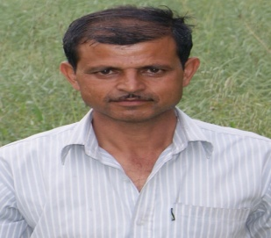
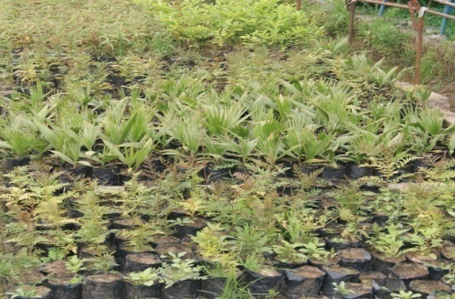
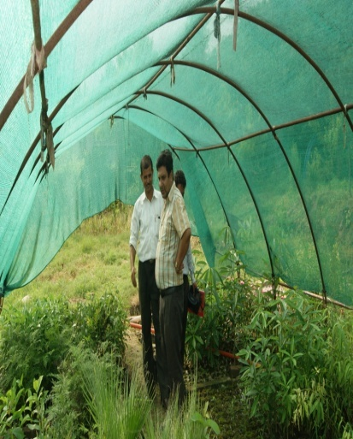
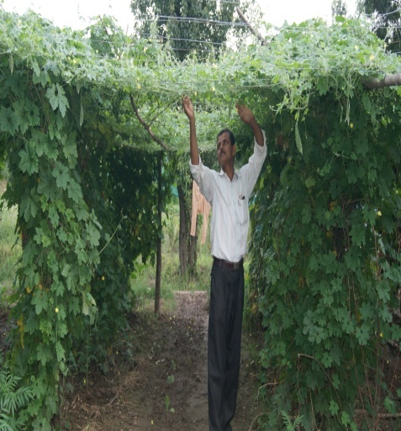
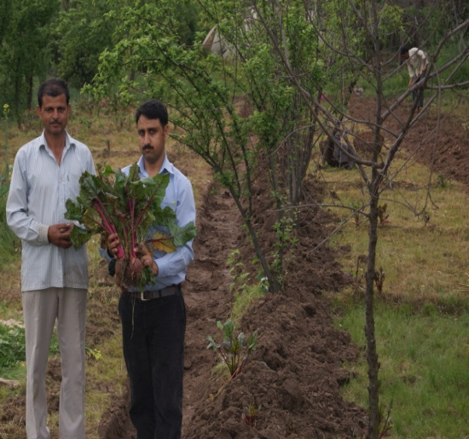
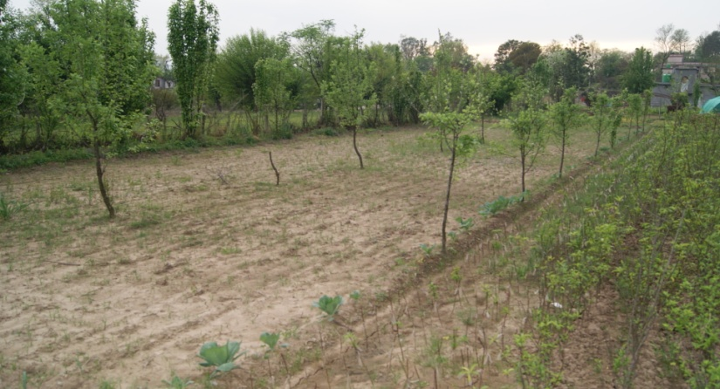
Sh. Ramesh Chander Sharma
S/O Sh. Kaka Ram
R/o Siot, Rajouri
Economics of Conventional Farm
Farm component | Area ( acre) | Input cost (Rs) | Net Income (Rs)
Maize - wheat | 10.0 | 35000 | 47000
Land holding 25.0 acre
Adoption of diversified farming
Intervention
Planted Horticulture Fruit Trees {5.0 acres (1100 no’s)}
Cereal crops + Pulses + oilseeds
{15.0 acres}
Polyhouse for vegetable cultivation
{3600 sq f}
Nursery of fruit trees, MAP’s, Avenue trees
{ 0.25 acres}
Economics of Diversified Farm
Nursery saplings - Rs. 0.60 lakh/annum
Peach, Pear, Apricot, Mango - Rs. 0.60 lakh/annum
Cereals, pulses and oilseeds - Rs 1.10 lakh/annum
Tomato, Capsicum, Onion, garlic etc- Rs. 0.60 lakh/annum
Nearly 1,76,000 saplings of medicinal and aromatic plants, avenue trees etc are planted at the community lands, schools etc. till date.

Slide 2
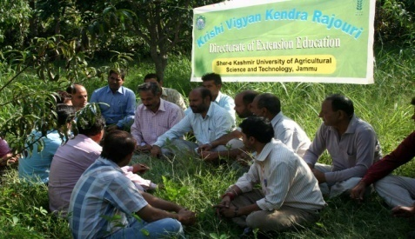
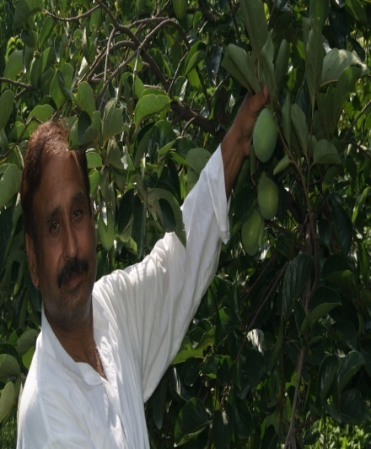
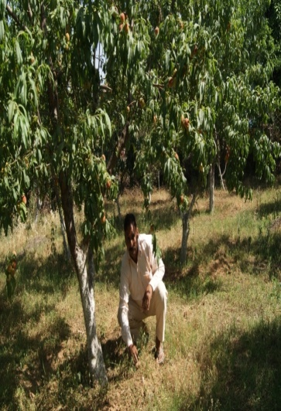
Sh. Tilak Raj Sharma
S/o Devi Dyal Sharma
R/o Dhangri Rajouri
Traditional farming of Wheat- Maize Net Income- Rs 24,000
Landholding:1.25 ha
Intervention
Wheat + Maize + Pulses
(0.4 ha)
Horticulture trees
(450 no’s in 0.8 ha)
Organic Vegetable Cultivation (16x 26 ft)
Returns from diversified farm:
Mango, Peach, nectarine, Apricot, Persimmon, etc- Rs 1,45,000
Organic Vegetables – Rs 70,000
(Broccoli,Cauliflower, Cabbage,cucurbits etc.)
Cereals and pulses - Rs 30,000
Saplings(fruit, MAP’s etc) – Rs 50,000

Slide 3
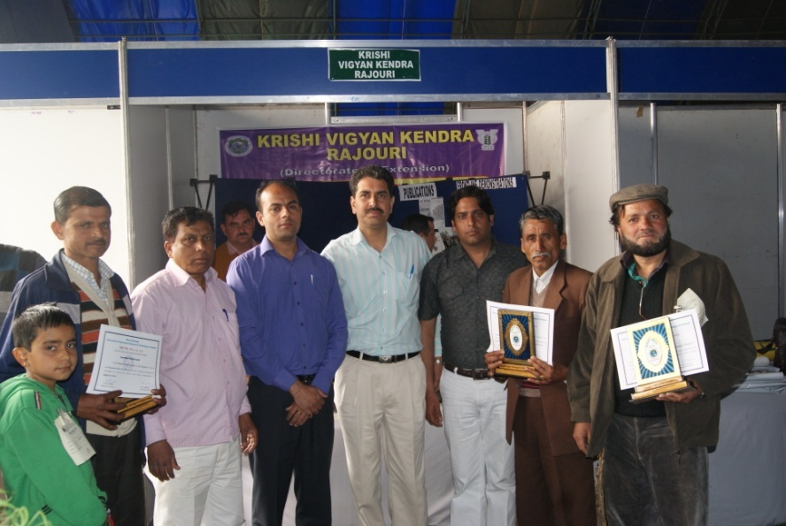
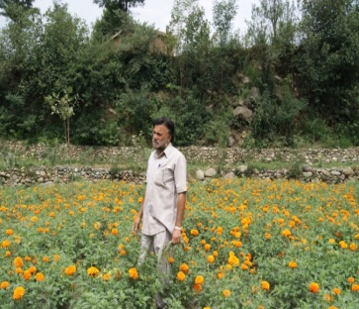
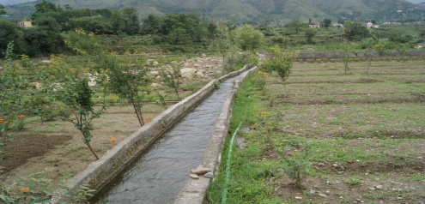
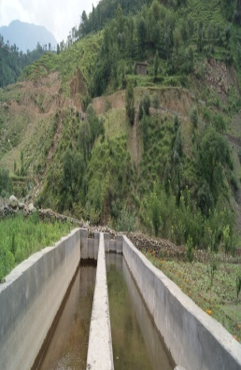
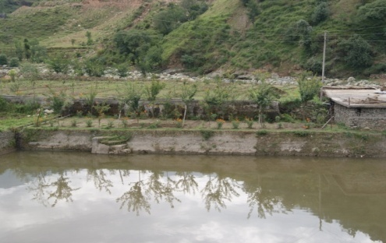
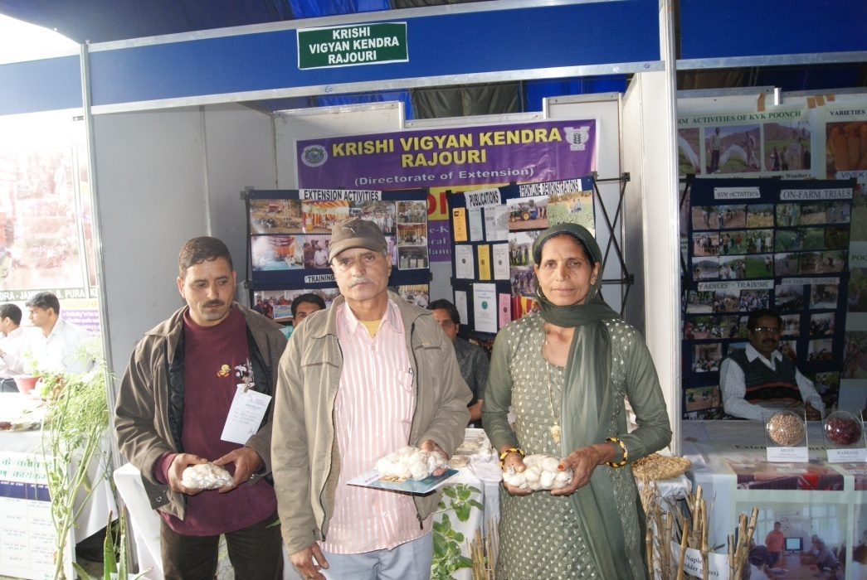
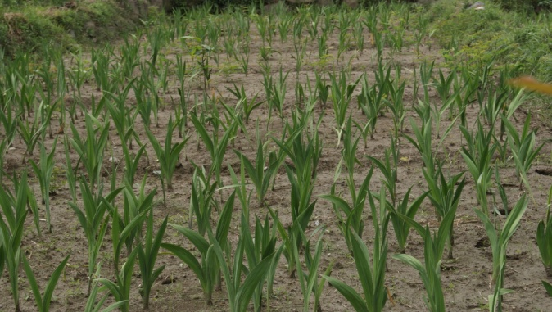
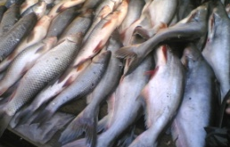
Mohd. Maqbool Raina
S/0 Gulam Mohu-ud-Din
R/0 Thanamandi, Rajouri
Traditional farming of Paddy-Maize
Landholding: 2.25 Ha
Input cost (Rs) | Net Income (Rs)
32,000 | 48,000
Fish Framing
Trout and Common Carp (Fresh Water)
Intervention
Cereals + Pulses + Flowers + Vegetable
(1.25 ha)
Fruit Trees
350 No’s
Mushrooms
Total Income
Trout- Rs 25,000
Common Carp – Rs 35,000
Gladiolus- Rs 15,000
Marigold – Rs 5,000
Peach, Pear, Apple, Rs 45,000
Apricot, Peacen nut
Organic Vegetables – Rs 40,000
(Beans, Rajmash, etc.)
Cereals and pulses - Rs 58,000
Mushrooms - new enterprise

